Slide 1
Dependency Injection in Spring
Dependency Injection
Dependency Injection (DI) is a design pattern.
Dependency Injection (DI) removes the dependency from the programming code so that it can be easy to manage and test the application.
Dependency Injection makes our programming code loosely coupled.
To understand the Dependency Injection (DI) better, first we have to understand Dependency Lookup (DL).

Slide 2
Dependency Injection in Spring
Dependency Lookup
The Dependency Lookup is an approach where we get the resource after demand.
we get the resource(instance of A class) directly by new keyword
A obj = new AImpl();
We get the resource (instance of A class) by calling the static factory method getA()
A obj = A.getA();
Context ctx = new InitialContext();
Context environmentCtx = (Context) ctx.lookup("java:comp/env");
A obj = (A)environmentCtx.lookup("A");
We can get the resource by JNDI (Java Naming Directory Interface)

Slide 3
Dependency Injection in Spring
Problems of Dependency Lookup
tight coupling The dependency lookup approach makes the code tightly coupled. If resource is changed, we need to perform a lot of modification in the code.
Not easy for testing This approach creates a lot of problems while testing the application especially in black box testing.

Slide 4
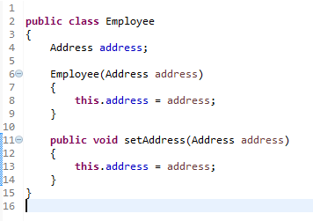
Dependency Injection in Spring
Dependency Injection
The Dependency Injection is a design pattern that removes the dependency of the programs.
In such case we provide the information from the external source such as XML file. It makes our code loosely coupled and easier for testing.
In this example, instance of Address class is provided by external source such as XML file either by constructor or setter method.

Slide 5
Dependency Injection in Spring
Dependency Injection
By Constructor
By Setter method
Spring framework provides two ways to inject dependency

